Slide 1
Sequencer board MKII : GS / Freedom electronics design
Has the SWO trace signal been brought out to the debug header?
See you tube phil’s lab

Slide 2
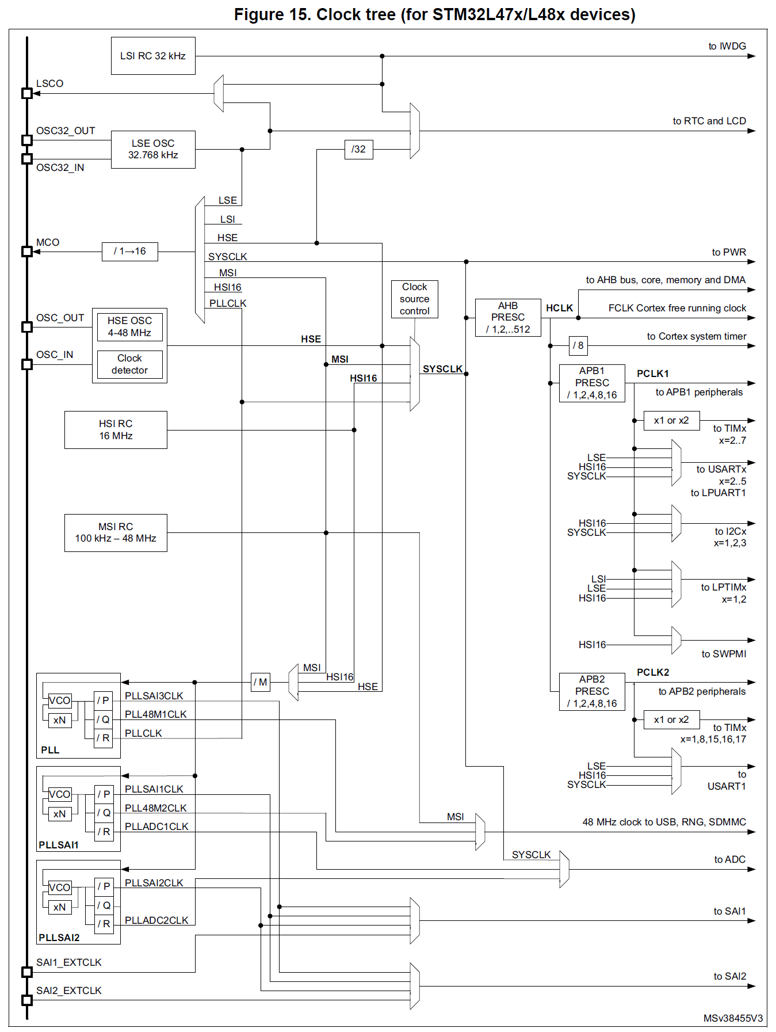
RCC (Reset & Clock Control) configuration
8MHz – too high hence not installed
/16
2.5MHz
RCC_MCO: Master clock output
PA8
/1
40MHz
40MHz
HSE Missing
40MHz
40MHz
/1
40MHz
High speed internal RC based clock
40MHz
/2,x10, /2
Multispeed internal RC based clock

Slide 3
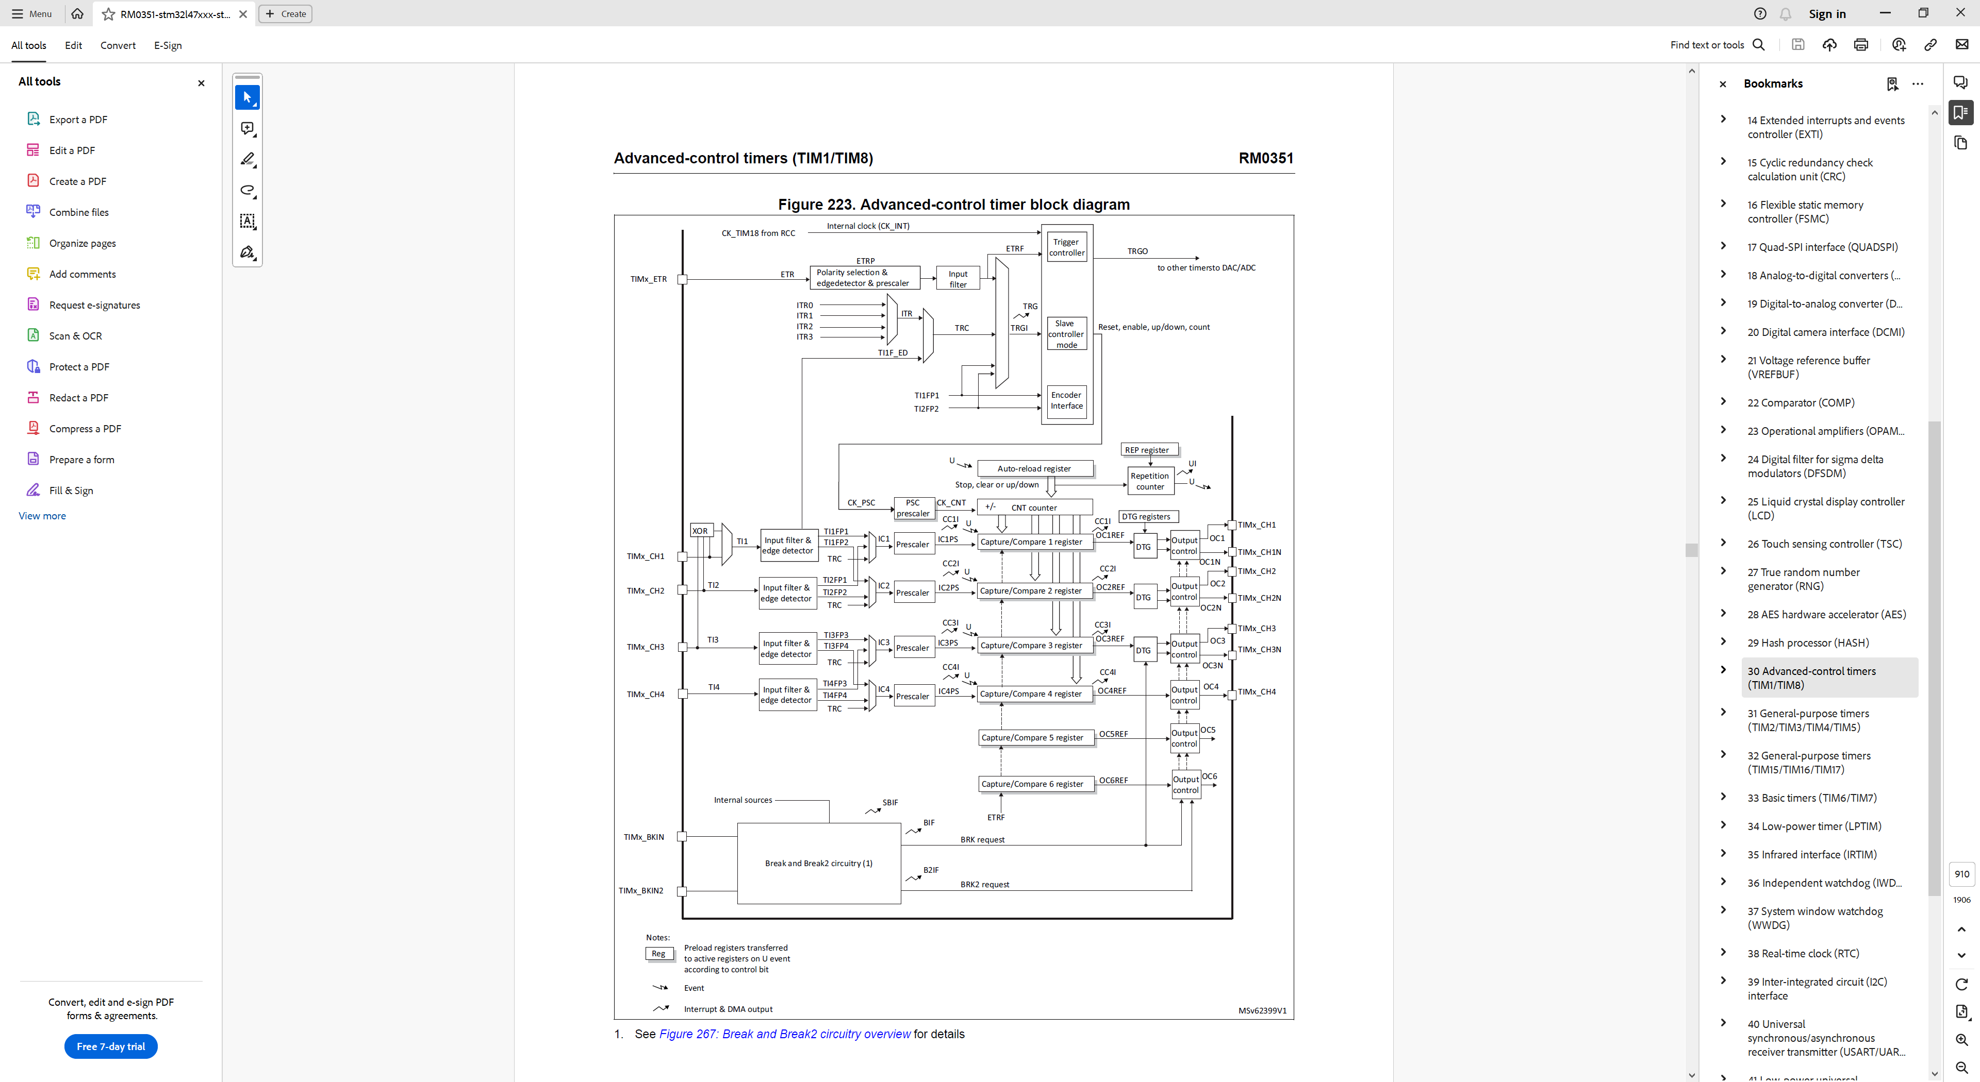
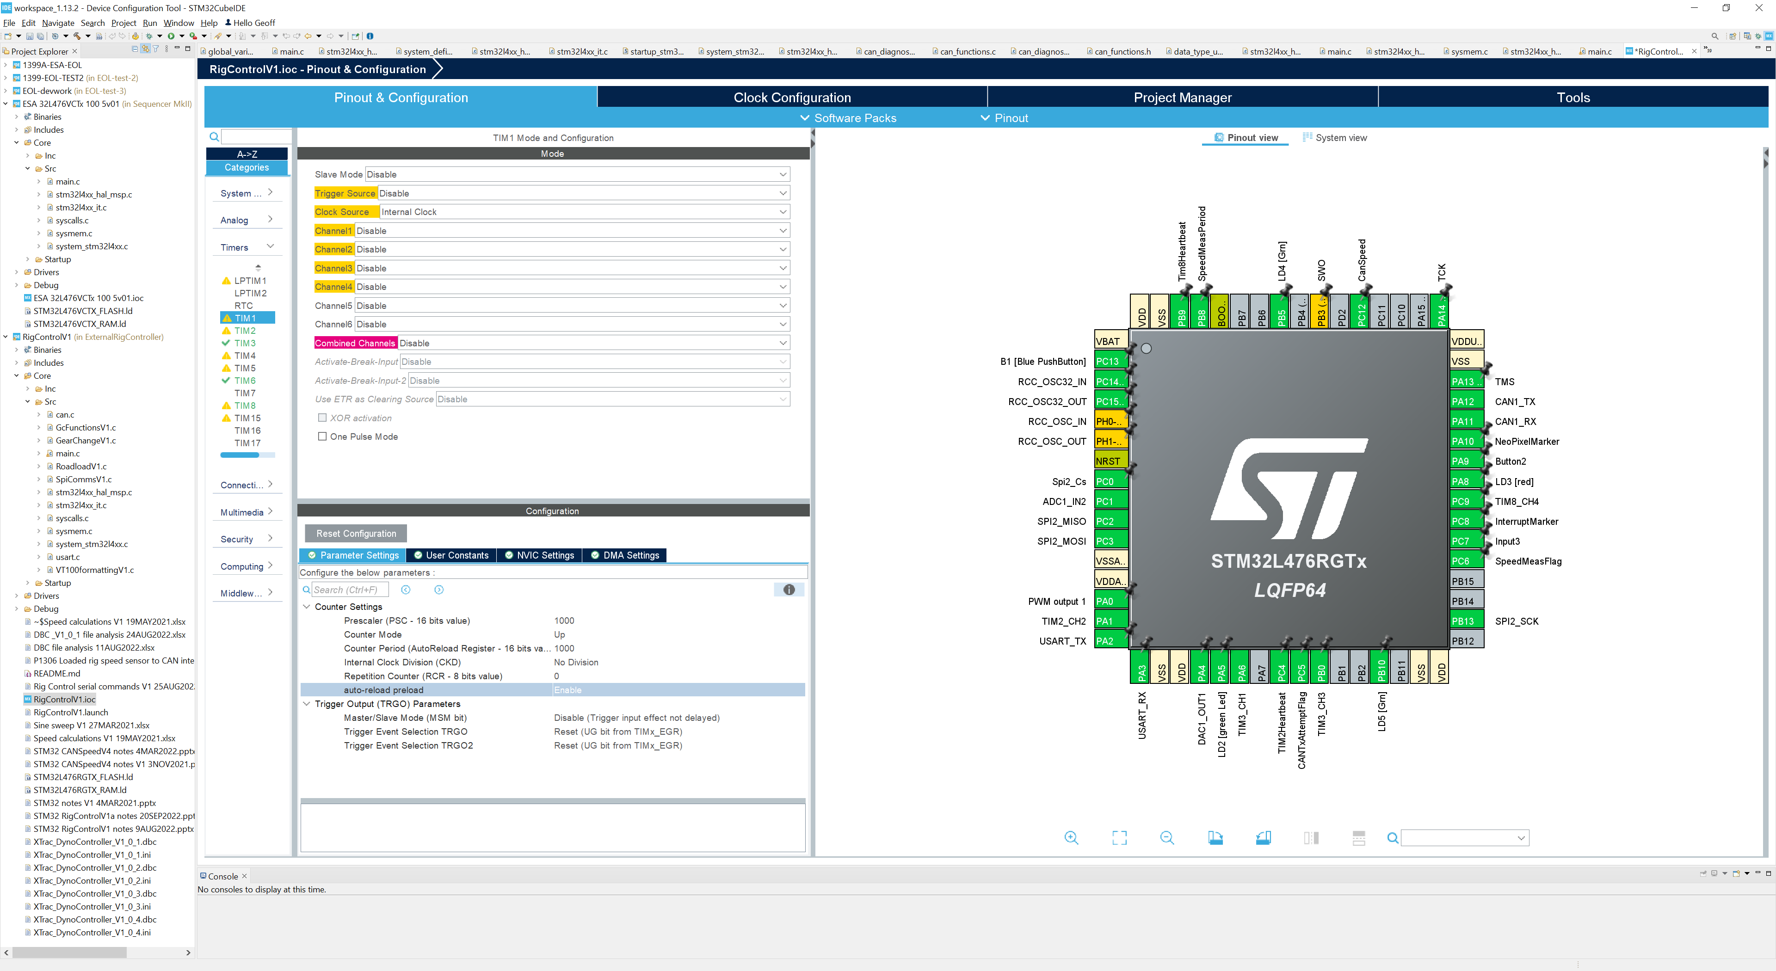
TIM1 configuration
40MHz
999
1000
40kHz
40Hz

Slide 4
999
Reload
Update event
1kHz
/39
Prescsaler
CK-CNT
1MHz
Timer 1
40MHz
RST

Slide 5
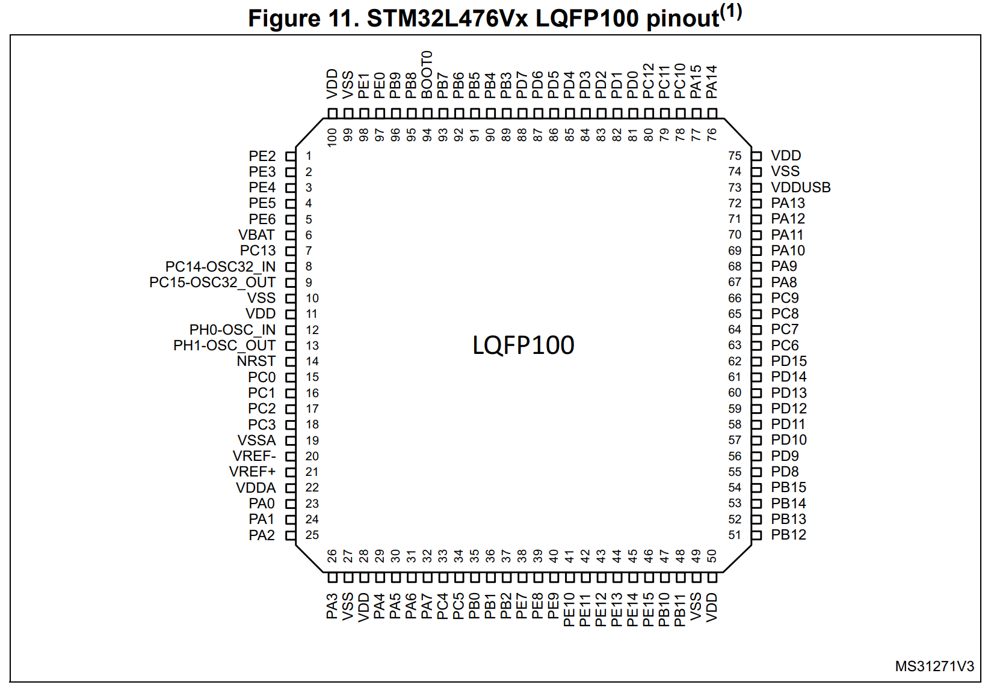
CAN_RX
CAN_TX
PD0: HSD1
RCC_MCO
DAC1
DAC2

Slide 6
DAC voltage reference
-Vref needs to be tied to AVss
AVdd
AVdd
+Vref
+Vref
2.048 or 2.5V bandgap reference
DAC
DAC
To ADC Vref
-Vref
-Vref
AVss
AVss
+Vref pin is an input!
+Vref pin is an output!

Slide 7
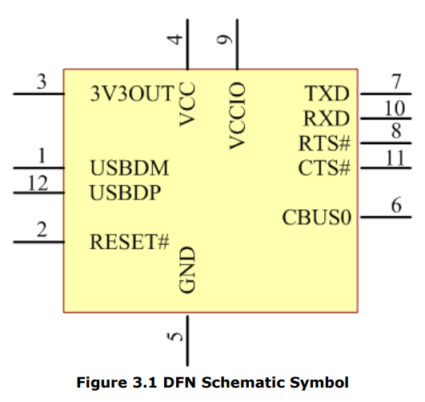
UART interface
FT234XD-R
Fuse removed
5V
USB

Slide 8
To do:
Link +Vref to Avdd
Link –Vref to Avss
Remove USB fuse
Is USB 5V linked to general 5v supply on board?
To do:
Link +Vref to Avdd
Link –Vref to Avss
Remove USB fuse
Is USB 5V linked to general 5v supply on board?
Are keyswitch inputs 5V tolerant?
Power for I2C bus expander (MCP23017)? – 5V but not shown on circuit diagram along with C26
I2C pullup resistors? On both busses?
I2C device memory & port expander are on separate buses!
CAN connector on flying lead
Analogue outputs saturate with only a fraction of DAC output swing
Fuse removed from USB power supply – plug a USB cable in and we get an ‘unrecognised device’ error
FTDI device configuration?
Dummy loads for HS & LS drive
RS485 comms interface & cabling

Slide 9
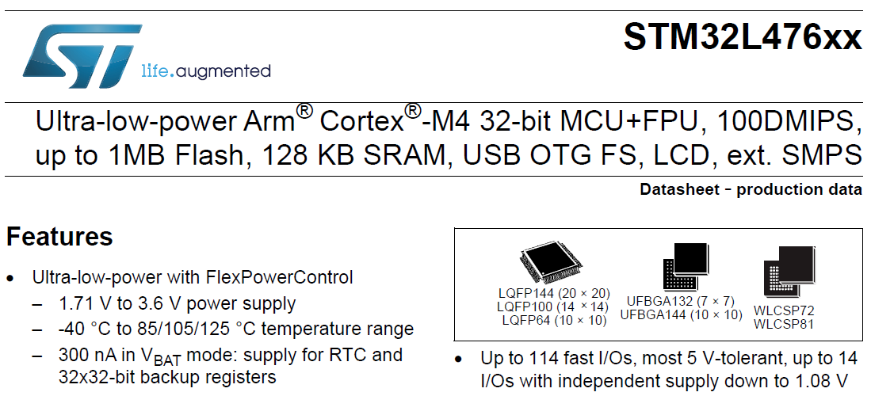
Which GPIO are 5V tolerant?

Slide 10
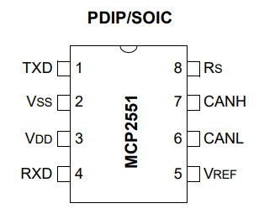
PB9
PB8

Slide 11
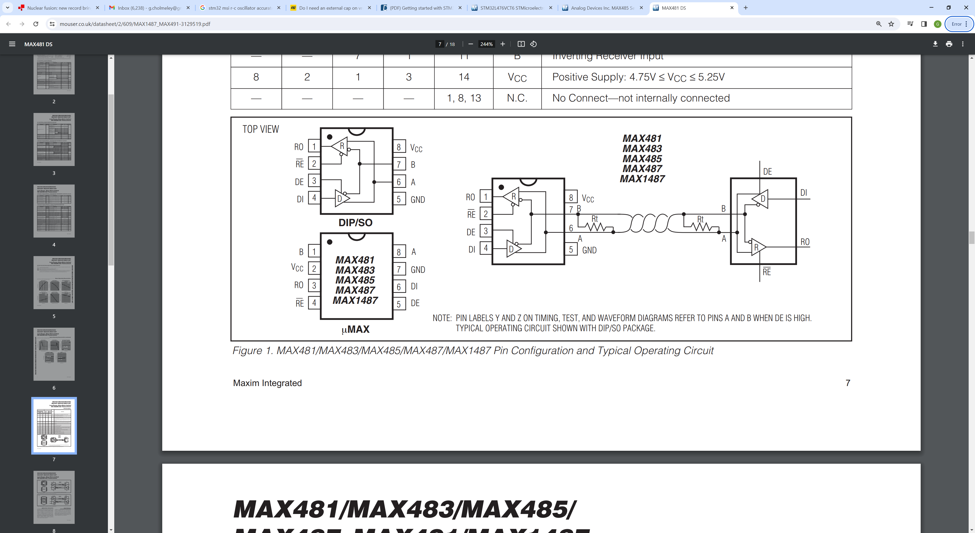
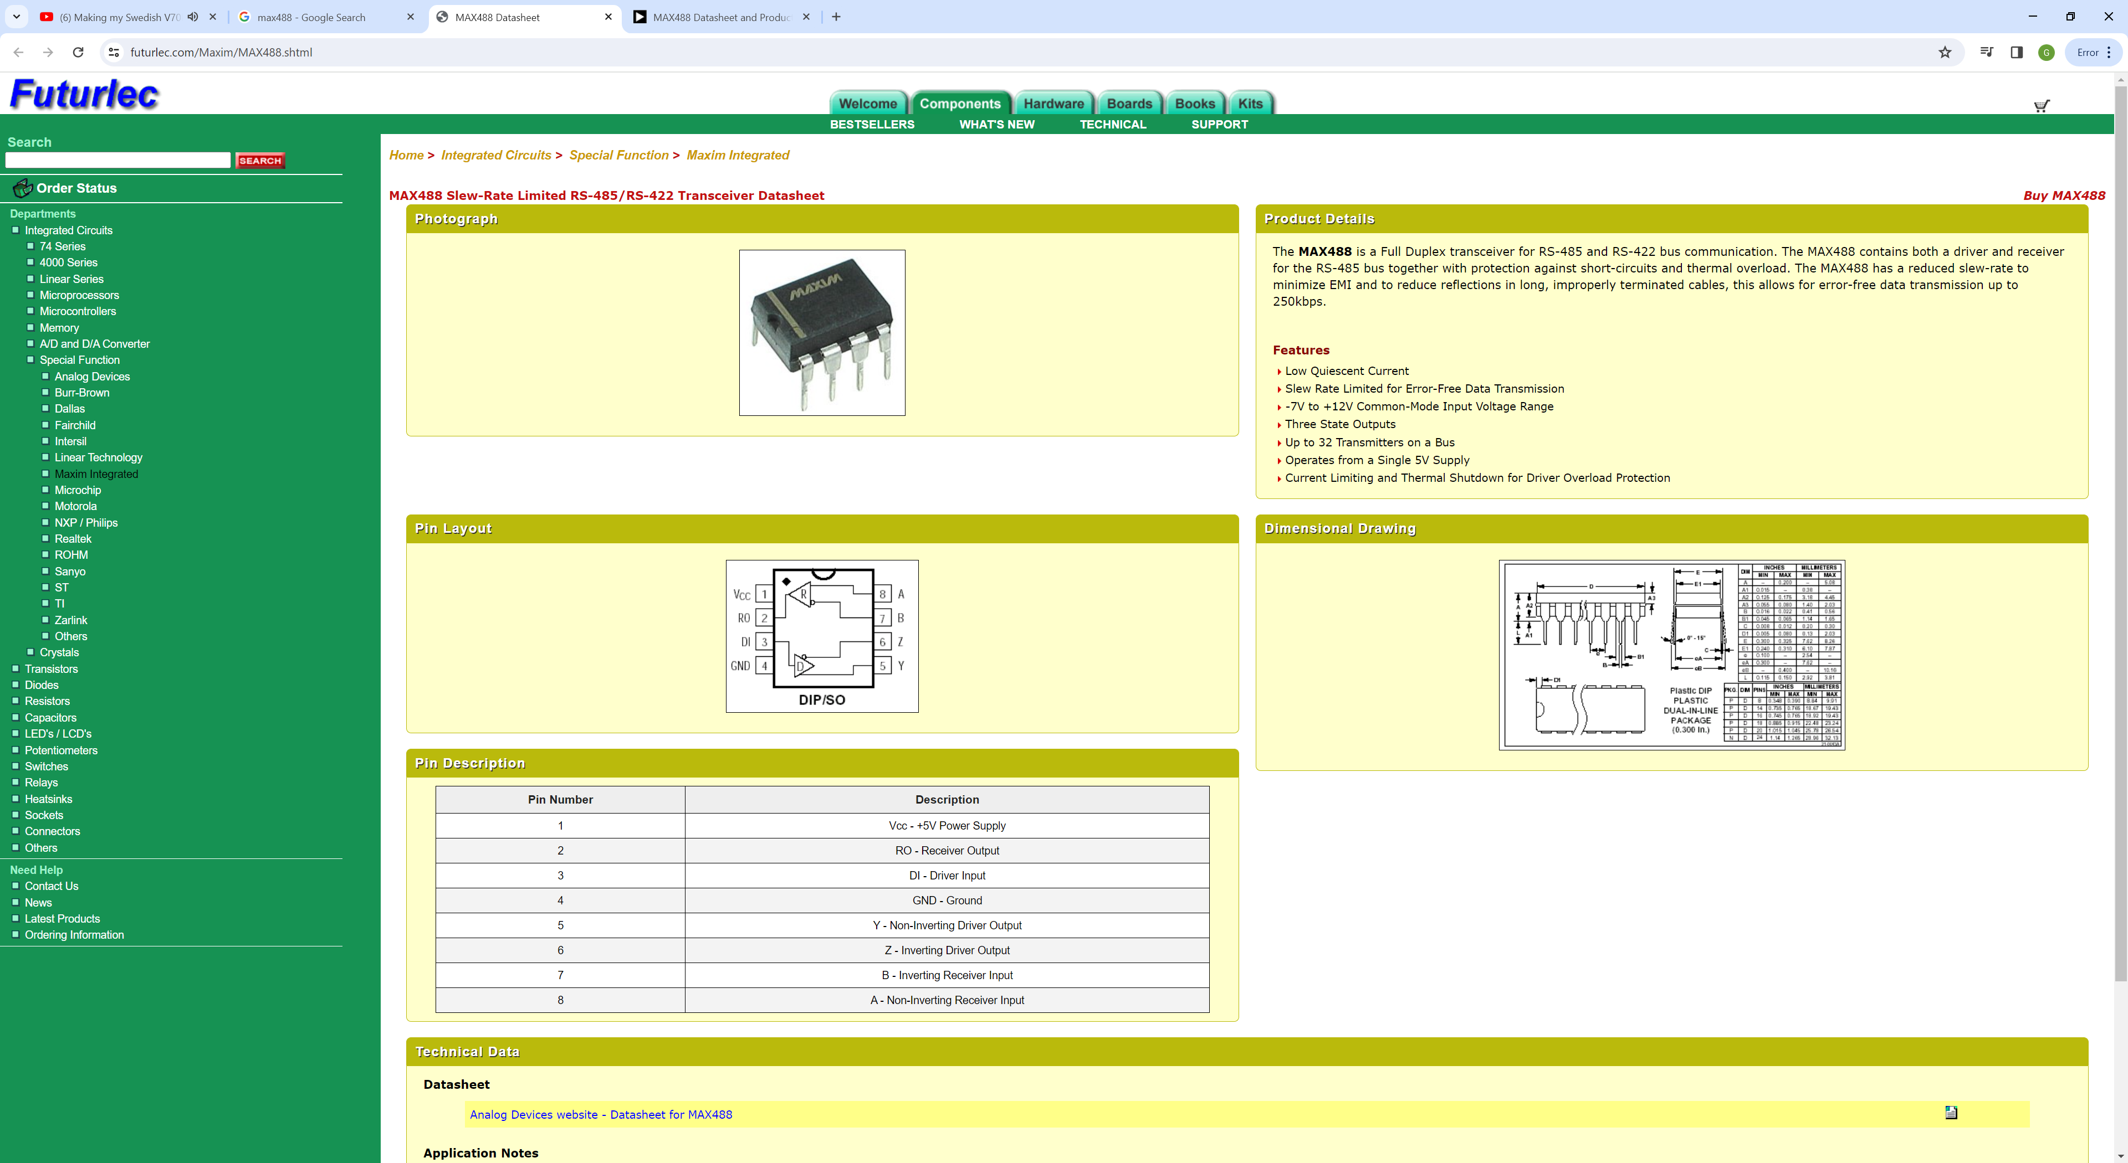
USART3
MAX485 comms
PC4
PC5
Is silk screen incorrect?
Tx
B
A
Z
Rx
Y
Sequencer connection

Slide 12
CAN interrupts:
To enable interrupts:
HAL_CAN_Activation(CAN_HandleTypeDef * hcan, uint32_t ActiveITs)
CAN_IT_RX_FIFO0_MSG_PENDING | CAN_IT_ERROR
Why would you use the macro???
__HAL_CAN_ENABLE_IT(Handle, INTERRUPT)
__HAL_CAN_ENABLE_IT(&hcan1, CAN_IT_RX_FIFO0_FULL | CAN_IT_ERROR);

Slide 13
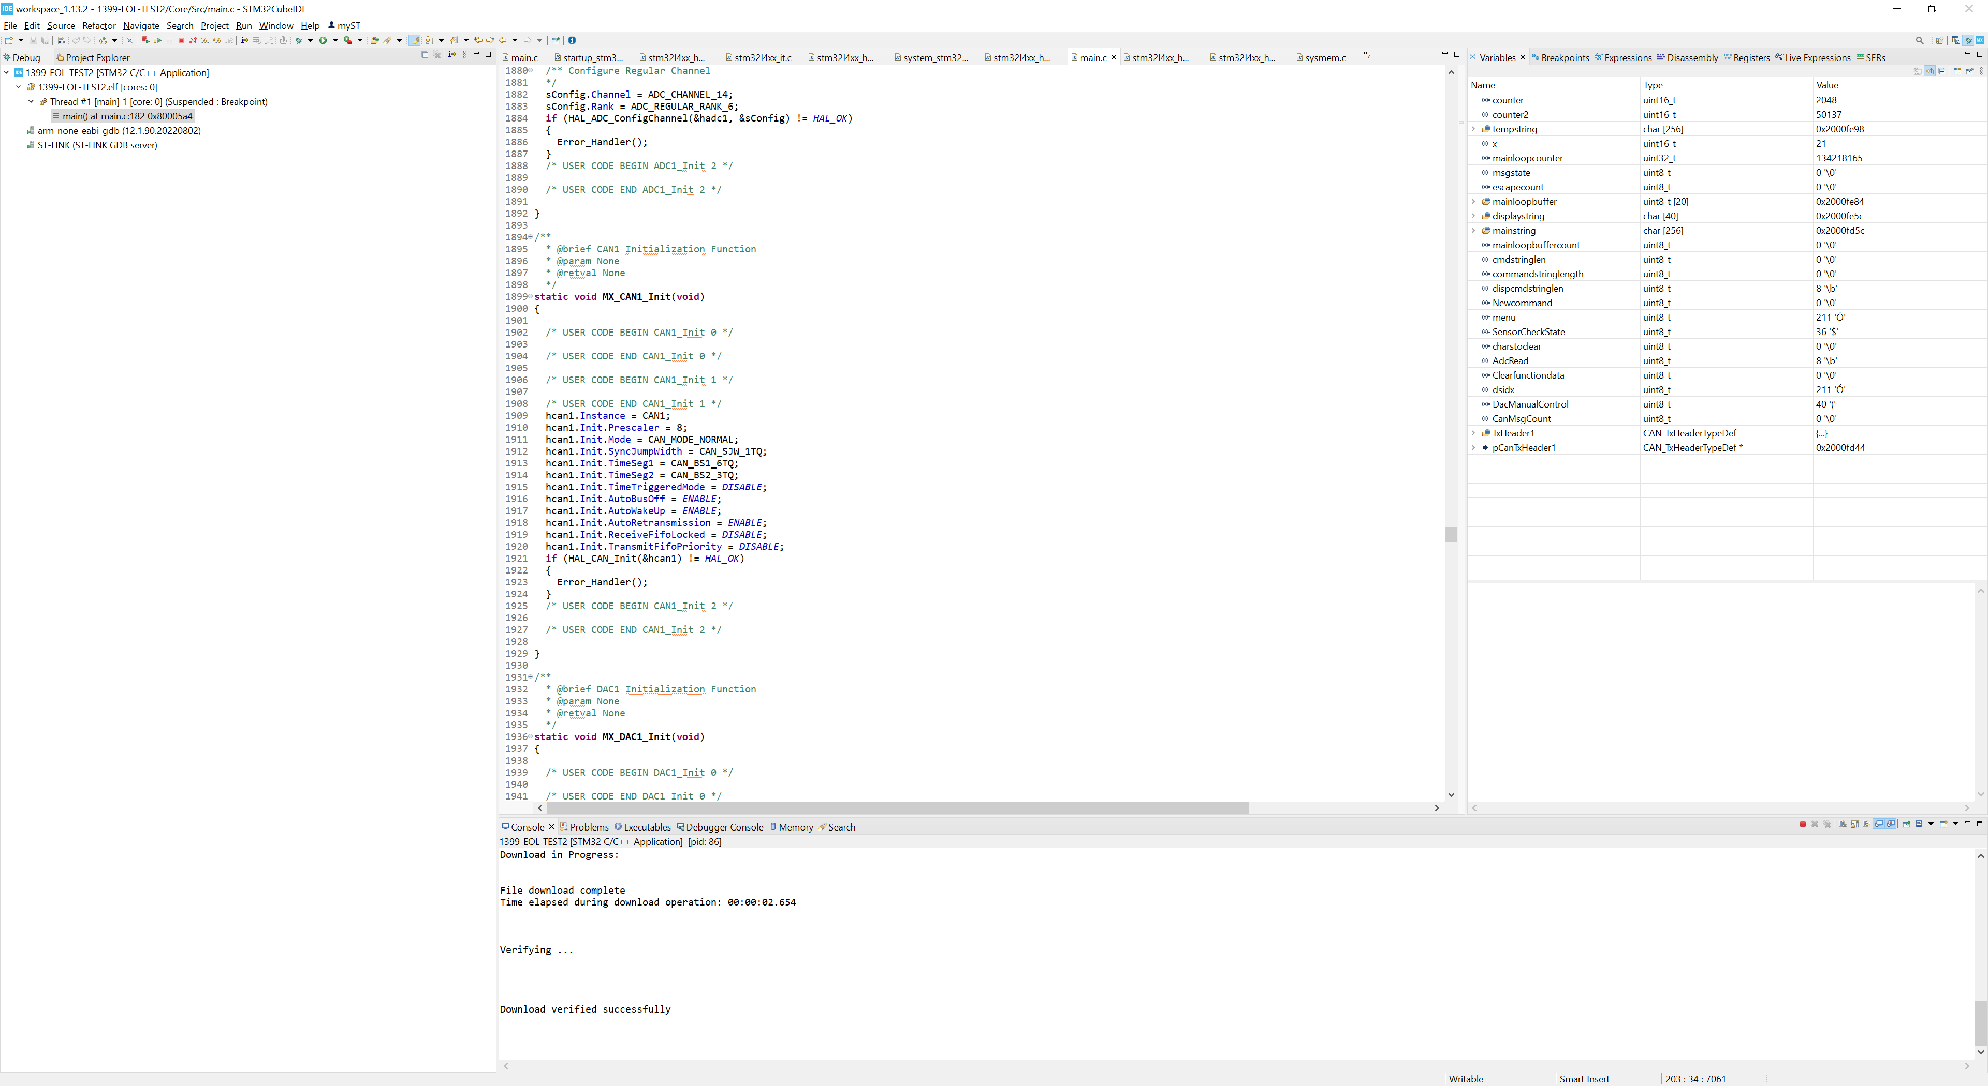
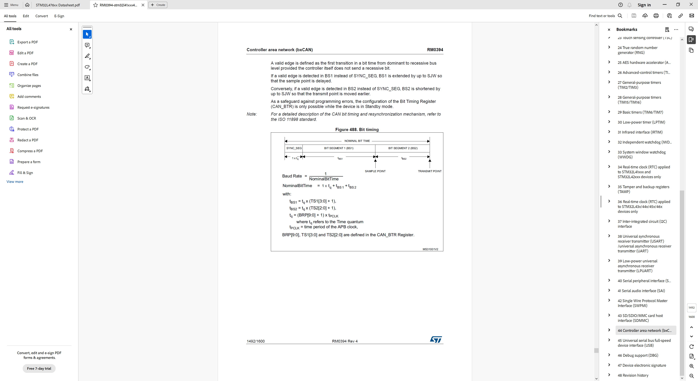
CAN setup

Slide 14
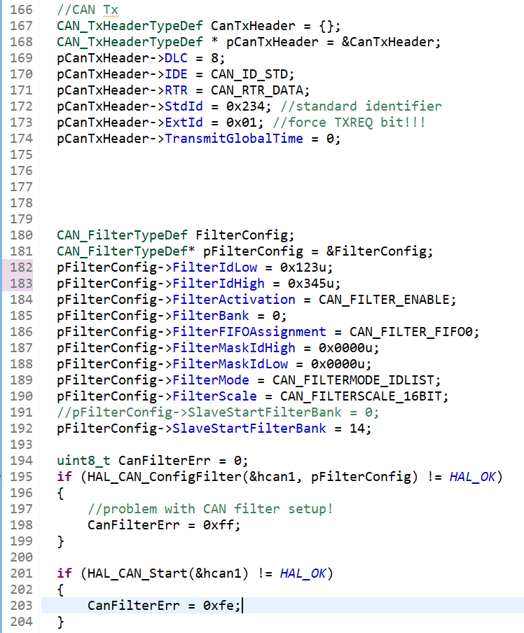
CAN setup

Slide 15
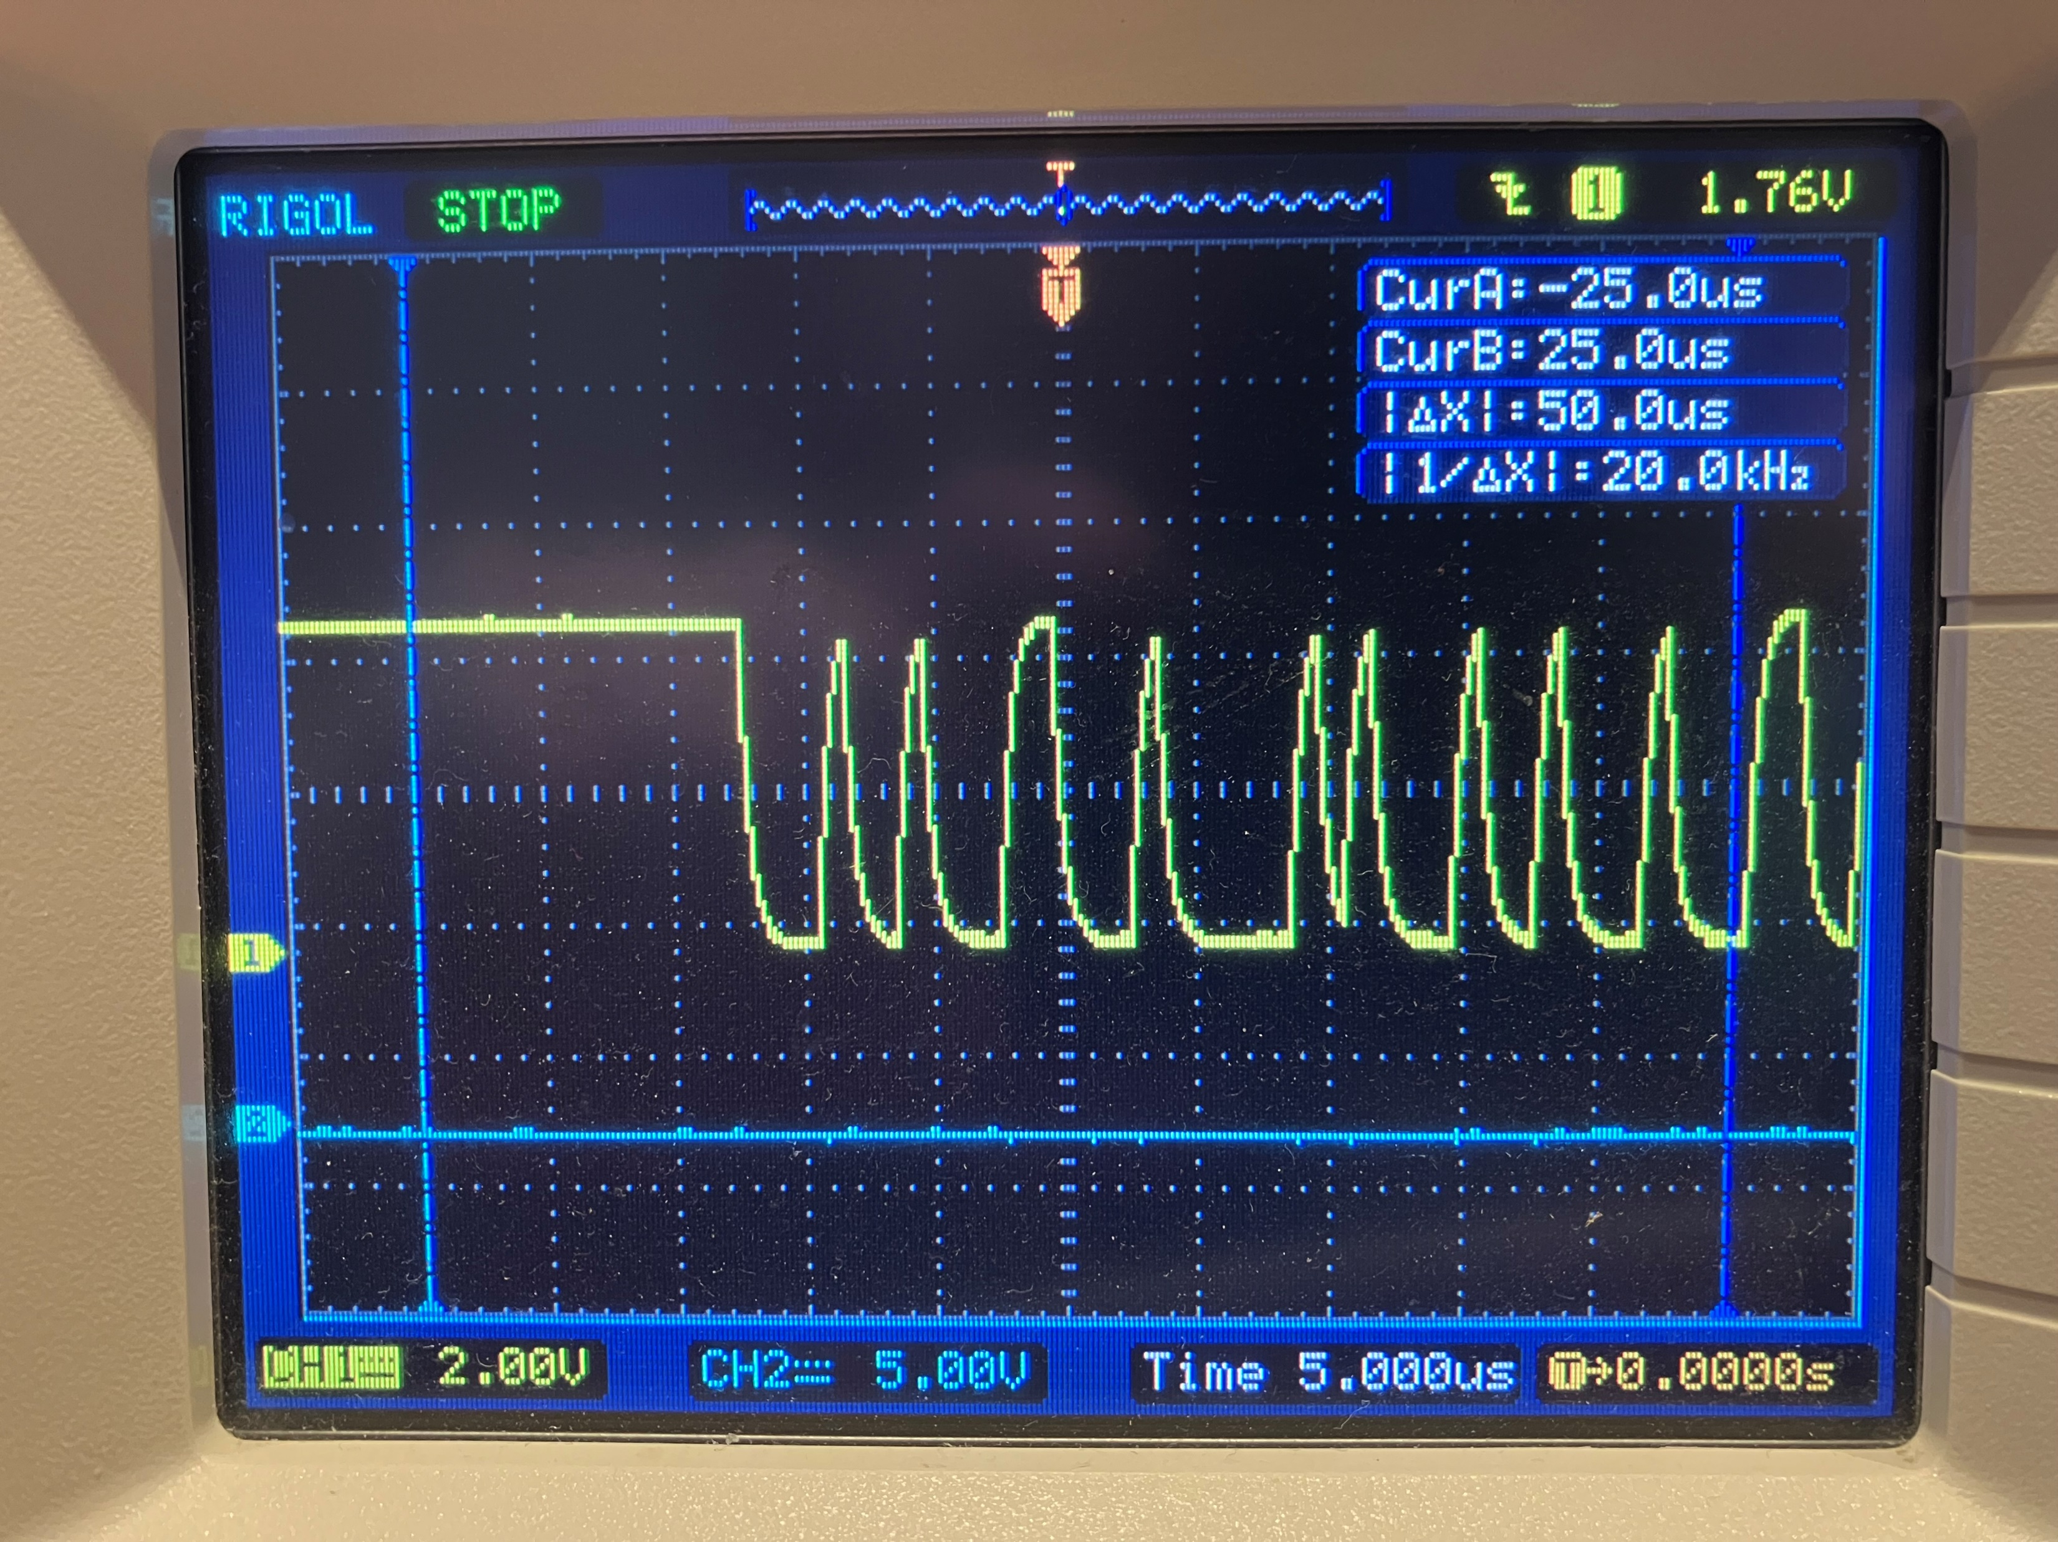
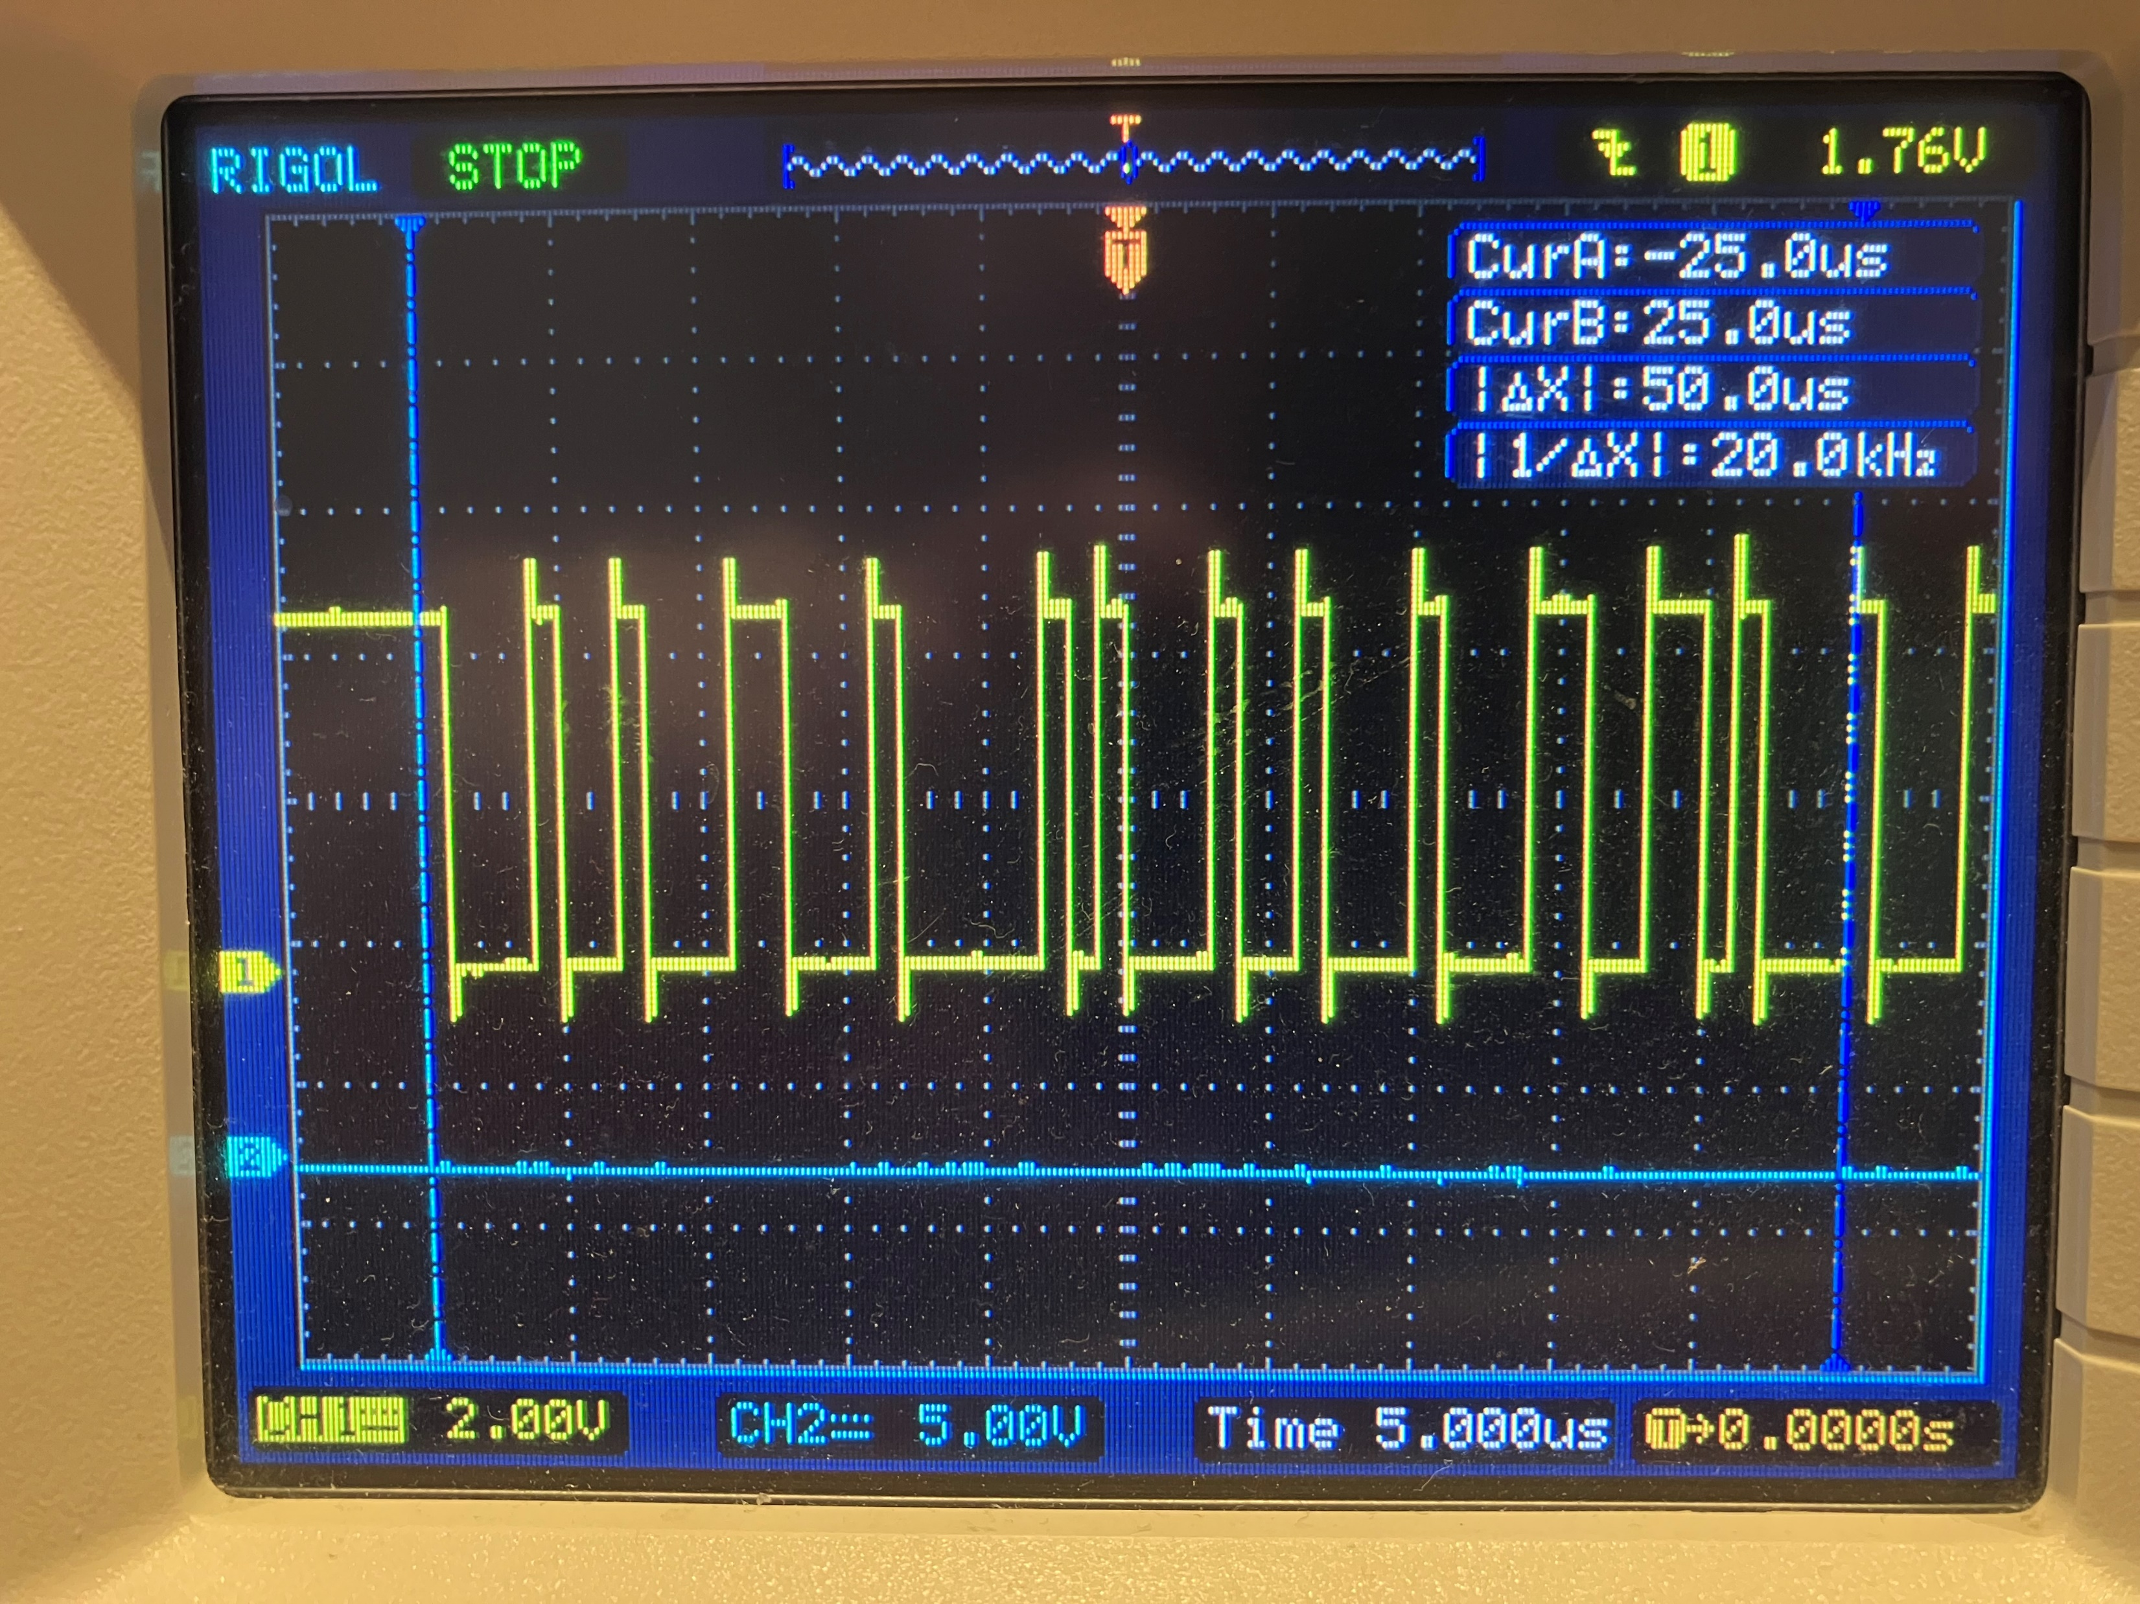
MCP2551 (U5) p4:
CANRx Input to uC PB8: 10k series resistor too strong!!!
TTL CAN data output from PCAN
10k seems to be OK on the RS485 driver

Slide 16
CAN issue on P1399 EOL test setup:
CAN transceiver wasn’t being enabled
Sequencer 2:
High value series resistors seem to be distorting original CAN pulses
PCAN seemed to stop working with the hardware!!!! Unplug and restart app got it working again!

Slide 17
CAN message reception
HAL_CAN_ActivateNotification(&hcan1, CAN_IT_RX_FIFO0_MSG_PENDING)
CAN message reception
void HAL_CAN_RxFifo0MsgPendingCallback()
HAL_CAN_GetRxMessage()

Slide 18
MISRA rules: place a u after an unsigned int value

